Slide 1
Ai2c technician cohort 7 lesson 1: intro to python

Slide 2
AI2C Technician cohort 7
Admin

Slide 3
Class Schedule
Date | Day | Time | Location | Topic
14-Jul | Monday | 9:00:00 AM - UTC | AI2C Conference Room | Intros/Ice Breaker, Environment Setup, and Python Basics
15-Jul | Tuesday | 9:00:00 AM - UTC | AI2C Conference Room | Networking Basics
18-Jul | Friday | 9:00:00 AM - UTC | AI2C Conference Room | Linux and Git Basics
21-Jul | Monday | 9:00:00 AM - UTC | AI2C Conference Room | Conditional Statements, Error Handling
22-Jul | Tuesday | 9:00:00 AM - UTC | AI2C Conference Room | File I/O and Git
23-Jul | Wednesday | 9:00:00 AM - UTC | AI2C Conference Room | IPv4 and Subnetting
28-Jul | Monday | 9:00:00 AM - UTC | AI2C Conference Room | Writing Clean Code
30-Jul | Wednesday | 9:00:00 AM - UTC | AI2C Conference Room | Cloud Computing
1-Aug | Friday | 9:00:00 AM - UTC | AI2C Conference Room | Algorithms and Data Structures (Lists, Dictionaries, Sets), Python OOP

Slide 4
Class Schedule
Date | Day | Time | Location | Topic
4-Aug | Monday | 9:00:00 AM - UTC | AI2C Conference Room | NumPy, Pandas
6-Aug | Wednesday | 9:00:00 AM - UTC | AI2C Conference Room | Cloud Resources
8-Aug | Friday | 9:00:00 AM - UTC | AI2C Conference Room | Handling command-line arguments and Kubernetes
11-Aug | Monday | 9:00:00 AM - UTC | AI2C Conference Room | AI/ML
13-Aug | Wednesday | 9:00:00 AM - UTC | AI2C Conference Room | DevOps/CICD
15-Aug | Friday | 9:00:00 AM - UTC | AI2C Conference Room | Small Project
18-Aug | Monday | 9:00:00 AM - UTC | CMU | CMU Orientation
20-Aug | Wednesday | 9:00:00 AM - UTC | TBD
22-Aug | Friday | 9:00:00 AM - UTC | TBD | Summer Graduation
25-Aug | Monday | TBD | CMU | Classes Begin

Slide 5
Today's Schedule
Time | Event
0900-0930 | Icebreaker and Intros
0930-1200 | Lesson 1
1200-1300 | Lunch
1300-1500 | Laptop/Environment troubleshooting and Lesson 1 Practice

Slide 6
Cohort Chain of Command – Team 1
First | Last | Rank
Terrence "TJ" | Allen | CPT
Douglas | Bonner | SFC
Raymond | Fernandez | SGT
Carlos | Gil | CW3
Colby | Johnson | SGT
Nicholas | Lind | SGT
Steve | McCoy | CW2
Enrique | Mosqueda
Larry | Parrotte | CW2
Ashley | Rivera | CPT
Benjamin | Siegel | 1LT
Dylan | Temple | SGT

Slide 7
Cohort Chain of Command – Team 2
First | Last | Rank
William | Benitez | SFC
Roni | Brown | 1LT
Kale | Gallo | CW2
Jonathan | Hale | SSG
Jamison | Kelly | SGT
DongDong | Liu | 1LT
Ian | McGrady | SGT
Josiah | Park | CPT
Markuz | Robinson | SFC
Elisa | Sun | CPT
John | Tomaselli | MAJ

Slide 8
Cohort Chain of Command – Team 3
First | Last | Rank
Cole | Bishop | CW2
Adriana | Canedo | SFC
David | Gibbons | SSG
Nathan | Hodge | SFC
Richard | Kovach | SFC
Antonio | Magana | SFC
Justin | McLellan | CW2
William | Park | SGT
Gabriel "Alex" | Santiago | CPT
Brandon | Taylor | SSG
Cory | Wingate | CW2

Slide 9
Icebreaker – Human Bingo
First 3 Bingos win a prize!
To win, you must be able to correctly identify the people on your card.

Slide 10
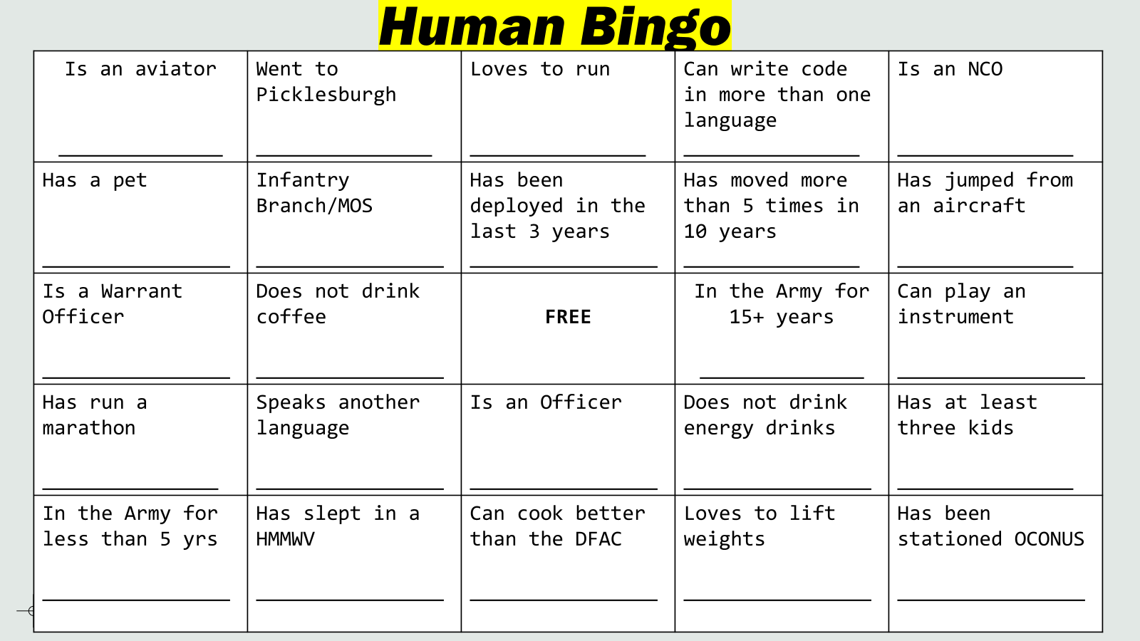
Icebreaker – Human Bingo

Slide 11
Intros
Name
Rank
What you do in the Army
Where you're coming from
Your experience level with AI/Tech/Coding
Notes:
.

Slide 12
expectations
College courses
Python experience
DevOps
Cloud
Garbage in, garbage out
Do the material
Optional exercises
Academic Freedom
What do you want out of this?

Slide 13
Laptop Issues?

Slide 14
AI2C Technician Cohort 7
Lesson 1 – Intro to Python

Slide 15
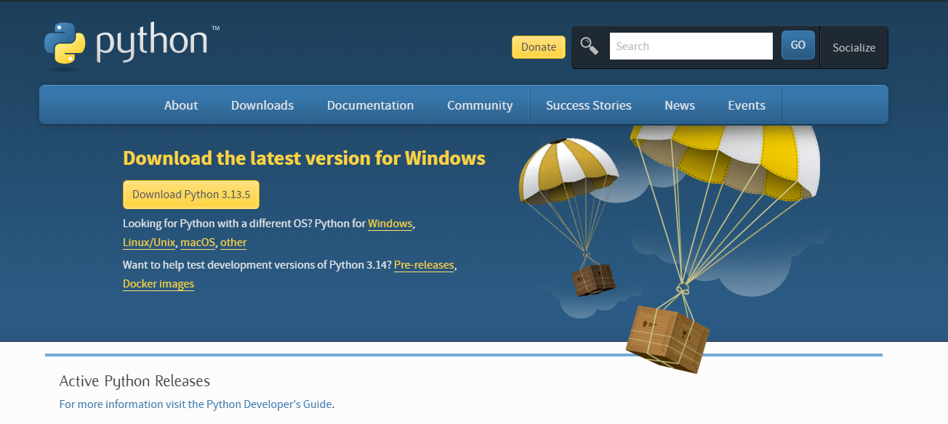
Let’s download Python
If you haven’t already… go to python.org and download the latest release of Python
Notes:
Take 3-5 minutes to let people download Python

Slide 16
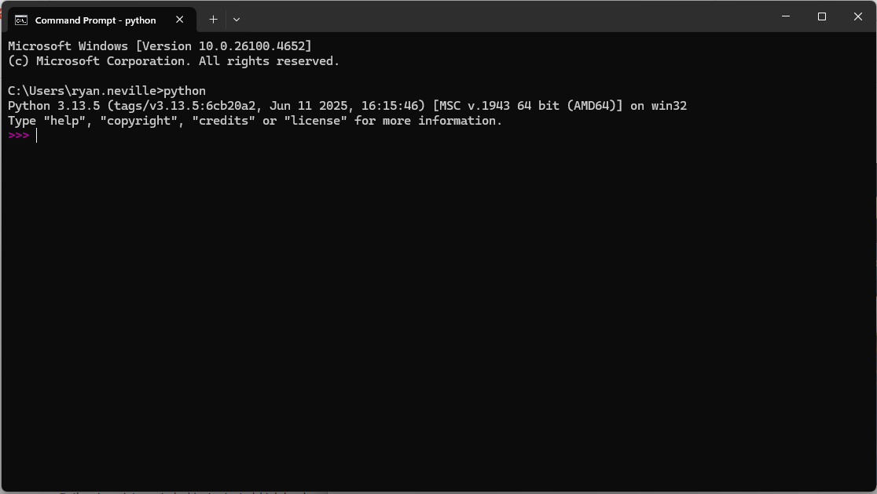
Verify the download
Open a command prompt and type in “python”. Your terminal should indicate it is running Python with the “>>>”
Run a few basic commands.
x = 5
x+2

Slide 17
Interactive Python
Running Python in the terminal like this is great way to interactively see what individual lines of code do but…
Oftentimes we want to run dozens (or hundreds) of lines of code at a time. For this, we want to write python scripts.
It would also be nice if there was software that would help us write and manage code, have useful plugins, be integrated with AI, etc…
We need an Integrated Development Environment (IDE)
Notes:
Give 3-5 minutes for download

Slide 18



Integrated Development Environments (IDE)
There are many IDEs that can help you write and manage code.
Visual Studio Code
PyCharm
Notepad++

Slide 19
Visual Studio Code
We use VS Code in AI2C, and you will use it for classes at CMU.
VS Code has great version control management built in and many great plug-ins
Take a few minutes to download VS Code

Slide 20
Running code in VS Code
Give a quick tutorial on
Creating a Folder
Creating and running a Python Script in the VS Code terminal.

Slide 21
Saving Code on the Internet and version control?
Go to https://github.com and setup a github account.
Also download git at https://git-scm.com.
We will have classes on how to use github and git later, but you will need a github account and git to pull in-class exercises and solutions.

Slide 22
So what is Python?
Python is a high-level, interpreted programming language known for its simplicity, readability, and versatility.
Python is widely used by beginners and professionals alike. It can be used for a wide range of applications from web development, data science, automation, and artificial intelligence.

Slide 23
Data and datatypes
This is important.
Computers classify data into different datatypes. For instance:
6 is an integer
25.5 is a floating point number (float)
“Hello” is a string
Python will interact with different datatypes differently.

Slide 24
Datatypes
Give examples of the following:
Integers
Floats
Strings
List
Tuple
Dictionary
Set

Slide 25
Immutable vs Mutable

Slide 26
Variables can hold any data types
Floats - decimal numbers
Integers - whole numbers
+, -, *, /
**, //
PEMDAS

Slide 27
Variables can hold any data types
Boolean - True/False or 1/0
==, !=, > <
bool (“My String”) bool(“”)
Not, And, Or
Strings - collection of characters held by single/double quotes
Multiline strings
Escape characters (“\”)
Concatenation
Indexing/Slicing

Slide 28
Instances can be stored in Data Structures
Lists - Ordered, mutable collection of elements that do not have to be the same type
[], list(), list comprehension
Indexing, slicing
Length
Concatenation
Iterable
Dictionaries - unordered, mutable collection of key-value pairs
{}, dict()
.keys(), .values(), .items()
Adding an item
del

Slide 29
Instances can be stored in Data Structures
Tuples - an immutable collection of ordered items
(), tuple()
Indexing, Slicing
Length
Unpacking tuples
Sets - an unordered, mutable collection of unique, immutable items
{}, set()
.add(), .update()
.discard()
Length
Union, Difference, Intersection

Slide 30
Data Type Conversion (Casting)
There are predefined functions we can use to convert data from one type to another: int(), float(), and str(). Here are examples with int():
Notes:
Age1 = “18”
Age2 = “19”
Sum_of_ages = age1 + age2
Print(sum_of_ages) --🡪 1819
Let’s say I want to use how old you will be in 4 years.
Num = int(age1) + int(age2)
Print(num) --🡪 37
Print(type(num1))
Age1 = int(age1) <<< now age1 is an integer because we overwrote it.

Slide 31
In Class Exercise 1
Copy and run the following code. What did it do?
num1 = 10
num2 = 15
print(“The sum is”, num1+num2)
num3 = “10”
num4 = “15”
print(“The sum is”, num3+num4)

Slide 32
Variables
A variable is a named location in memory that stores a value. Every variable has a name, a value, and a type.
age = 27 This variable’s name is “age”, it’s value is 27, and its type is an integer
Occupation = “AI Tech” This variable’s name is “Occupation”, it’s value is, “AI Tech”, and it is a string.

Slide 33
Variable Naming Rules
You can name a variable anything but…
1. Your variable name can’t start with a number.
2. Your variable name cannot include special characters (&*^%!)
3. Your variable name cannot have any spaces
4. Your variable name cannot be a python keyword (for, if, else…)
(You’ll learn more keywords as you learn the language)

Slide 34
Variable Naming Best Practices and Conventions
1. Your variable name should describe something about the data. Make the name make sense.
2. use_snake_case_for_variables
3. UseCapWordsForClassNames
4. Use ALLCAPs for constants

Slide 35
Functions
A function is a named, reusable block of code that performs a specified task.
There are some functions that are predefined by the Python Language. We will be using built-in Python functions to explore and learn the programming language.
Examples of these built-in functions are…
print(), len(), type(), sum(), max()…

Slide 36
More about functions
Functions have a name… they take an argument… and they return a result.
In math, we have the sine function. What arguments does the sin() function take? What does the sine function return?
Much like this, built-in python functions may require a specific datatype as an argument, and they will return a specific datatype.

Slide 37
Operators
Assignment
Comparison
Code | Meaning
x = 3 | Assignment
x += 3 | Add and assign
x -= 4 | Subtract and assign
x *= 5 | Multiply and assign
x /= 3 | Divide and assign
x //= 3 | Floor divide and assign
x %= 7 | Modulo and assign
Code | Meaning
x < y | Less than
x > y | Greater than
x == y | Equal to
x <= y | Less than or equal to
x >= y | Greater than or equal to
x != y | Not equal to
Arithmetic
Code | Meaning
x + y | Addition
x + y | Concatenation
x - y | Subtraction
x * y | Multiplication
x / y | Division
x // y | Integer/floor division
x % y | Modulo (remainder)
-x | Negation
x ** y | Exponentiation
Logical
x += 1
is equivalent to
x = x + 1
and other assignment operators are similar.
Code | Meaning
x or y | True if either is true
x and y | True only if both are true
not x | True if x is false
Reference: https://docs.python.org/3/library/stdtypes.html

Slide 38
Order of Operations
The order of operations in Python is essentially the same as in math you are already familiar with:
1. Expressions in parentheses
2. Exponentiation
3. Multiplication, division, integer division, and modulo (remainder)
4. Addition and subtraction
Operators with the same precedence (except for **) are evaluated from left-to-right. (In algebra we say they are left-associative.)
Notes:
PEMDAS
Please Excuse My Dear Aunt Sally
Parentheses, Exponent, Multiply/Divide, Add/Subtract

Slide 39
Take a Break

Slide 40
The built-in functions aren’t enough…
You can import more functionality into Python without downloading anything else… for this you use a standard module.
To use a module’s functions, you must first import the module. Add “import module_name” at the top of your program.
For instance…
import math
math.sqrt(100)

Slide 41
In Class Exercise
In groups of 3-4, research the following standard modules. What functions do these modules provide to Python? What are some use cases?
Math
Os
Random
Statistics
JSON
Http
Urllib
Notes:
PEMDAS
Please Excuse My Dear Aunt Sally
Parentheses, Exponent, Multiply/Divide, Add/Subtract

Slide 42
Ice Breaker: The Pizza Argument
A Pittsburgh pizza shop is having a two-for-one deal. You can get two small (12”) pizzas for $9.99. In contrast, a large pizza (16”) costs $9.99. Which one is the better deal (yields more pizza)?
What is your first intuition?
With a partner, write Python code to answer this question.
Use the math module (math.pi) when calculating the area of the pizzas.

Slide 43
More practice
Open a new folder in VS Code.
Open a terminal in VS Code (Ctrl + ‘~’) and type the following command.
git clone https://github.com/shafe123/AI2C-Prereqs.git
Work through Lesson01Practice.py

Slide 44
Final Exercise
1. Copy the lyrics of your favorite song into a string variable.
2. Determine all the unique words in the song and the number of times they occur.
*DISCLAIMER* You will not be able to do this with only what you have been taught so far. The intent is that you try to think through this for a little bit and inevitably look up a solution. This exposes you to some of the things we are going to learn later on.
5 different solutions for this are given in Lesson01FinalProblemSolution.py

